Slide 1
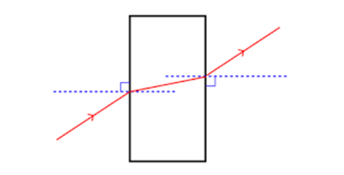
Daily Review
Refraction
When light rays enter a denser material, such as water from air, the light slows down and is bent towards the normal.
What happens to light rays when they pass from into a less dense material?
Why does the light bend this way?

Slide 2
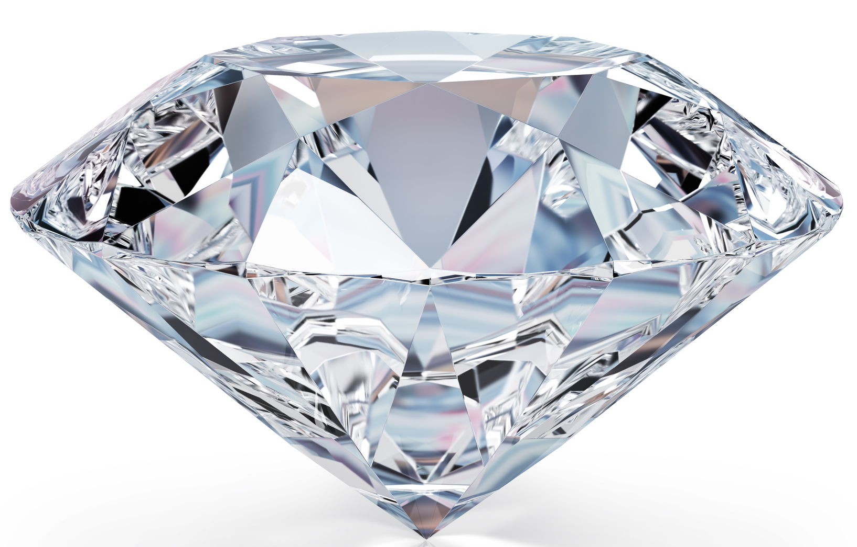
Skill Development/Guided Practice
Describing Refraction
Identify the refractive indices of the substances. State the change in refractive index: high to low / low to high Explain what happens to the speed of the light and which way it bends. Light slows down = bends towards normal Light speeds up = bends away form normal
Explain what happens to light as it passes from a diamond back into air.
Substance | Refractive Index
Air | 1.00
Water | 1.33
Perspex | 1.49
Glass | 1.53
Diamond | 2.42
Light is passing from a medium with a _____ refractive index to one with a _____ refractive index.
The light will _____ and bend _____ from the normal.

Slide 3

Daily Review
Depth Illusions
Light reflects off underwater objects and moves from water, through air.
Water is more dense than air, so has a higher refractive index.
Light is bent away from the normal when it leaves the water.
When the refracted light reaches your eyes, your brain traces the light rays back in a straight line.
Copy and complete the diagram to show why a fish appears closer to the surface than it really is.

Slide 4
Lenses Year 9 Physics

Slide 5
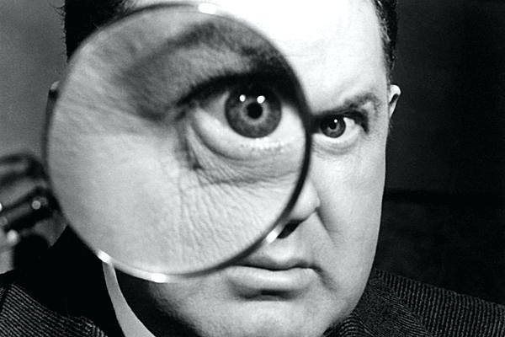
Learning Objectives
CFU
What are we going to learn?
Identify the different types of lenses.
Describe the types of images formed from lenses.
Activate Prior Knowledge
A magnifying glass is a type of lens.
Think, pair, share: What does a magnifying glass do? What other pieces of equipment have a similar function?

Slide 6
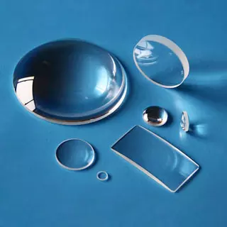
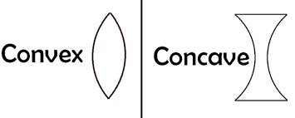
Concept Development
CFU 1
Why does a lens need to made of a transparent material?
Lenses
A lens is a curved piece of transparent material, such as glass or plastic.
As light passes through a lens, the light is refracted.
There are two types of lenses: concave and convex.
Concave lenses are thinner in the middle than at the edges.
Convex lenses are thicker in the middle than at the edges.
CFU 2
Think, pair, share: How is a concave lens different to a convex lens?

Slide 7
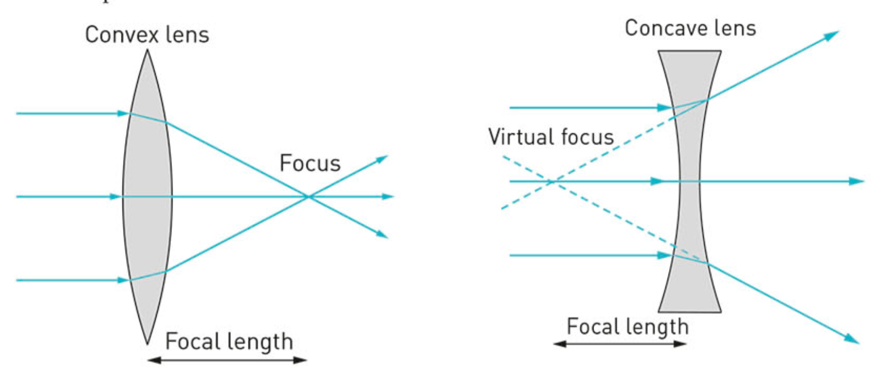
Concept Development
CFU 1
What do convex lenses do to light rays?
Convex Lenses
Convex lenses cause light rays to converge, or focus to a point.
The focal point is where the light rays cross.
For a lens, the focal length is measured from the middle of the lens to the focal point.
CFU 2
How is the focal length measures for a lens?

Slide 8
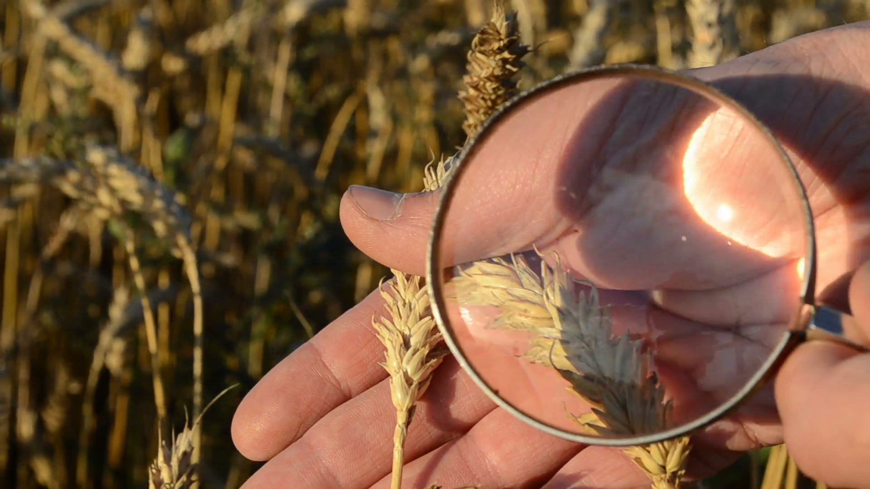
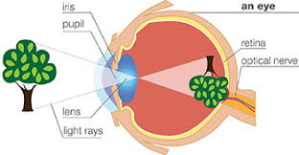
Concept Development
CFU 1
What does the image formed from a lens depend on?
Convex Lenses
Two types of image are produced by convex lenses, depending on the distance between the object and the lens.
When the object is very close to a convex lens, it produces a magnified and upright image.
This is the type of lens in a magnifying glass.
When the object is far from a convex lens, it produces a diminished and inverted.
This is how the lens in our eye forms an image.
CFU 2
What type of image is formed from the lens in our eye?
CFU 3
If an image is upright and magnified, where is the object relative to the lens?

Slide 9
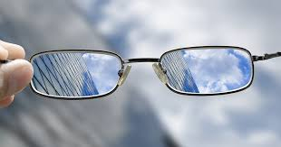
Concept Development
CFU 1
What do concave lenses do to light rays passing through them?
Concave Lenses
Concave lenses cause light rays to diverge, or spread out.
The light rays do not meet once they pass through the lens.
The focal point is found by extending the diverging rays back until they cross.
Images formed in concave lenses are always diminished and upright.
Concave lenses are used in glasses to correct certain sight problems.
CFU 2
How do you find the focal length of concave lenses?
CFU 3
What type of images are always formed in a concave lens?

Slide 10
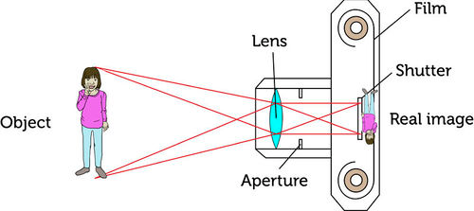
Skill Development/Guided Practice
Describing Images Formed With Lenses
Identify the type of lens used. Describe what the lens does to light rays passing through it: converges or diverges
The lens in the camera is a convex lens.
The lens is converging the light rays to form an image on the film in the camera.

Slide 11
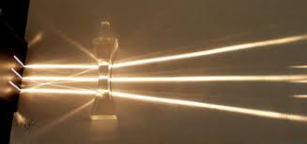
Skill Development/Guided Practice
Describing Images Formed With Lenses
Identify the type of lens used. Describe what the lens does to light rays passing through it: converges or diverges
This is a concave lens.
The lens is diverging the light rays so they cover a wider area.

Slide 12
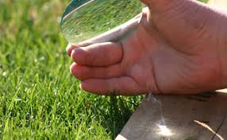
Skill Development/Guided Practice
Describing Images Formed With Lenses
Identify the type of lens used. Describe what the lens does to light rays passing through it: converges or diverges
The lens in is a convex lens.
The lens is converging the light rays to a single point, causing the paper to burn.
.

Slide 13
Skill Development/Guided Practice
Describing Images Formed With Lenses
Identify the type of lens used. Describe what the lens does to light rays passing through it: converges or diverges
The lens in the eye is a convex lens.
The lens is converging the light rays to form an image on the back of the eye.

Slide 14
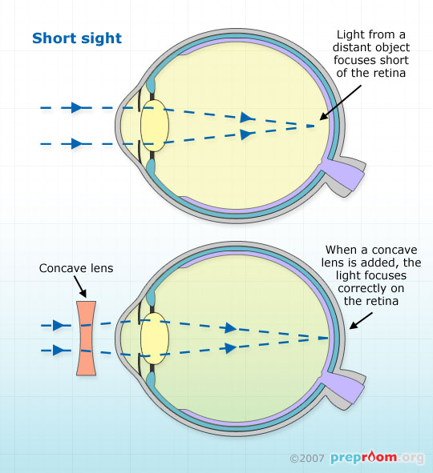
Skill Development/Guided Practice
Describing Images Formed With Lenses
Identify the type of lens used. Describe what the lens does to light rays passing through it: converges or diverges
This is a concave lens.
The lens is diverging the light rays before they enter the eye to correct short sightedness.

Slide 15
Relevance
Light refracts through lenses in predictable ways, producing different types of images.
Lenses have many applications:
They can be used to magnify an image so you can see detail more clearly.
They can be used to project images onto a screen.
They can be used to correct vision problems.

Slide 16
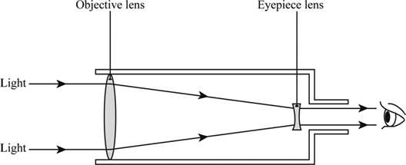
Skill Closure
Why are lenses made of a transparent material?
Skill Closure
What happens to light as it passes through a lens?
Skill Closure
A telescope has two lenses: the objective lens and the eyepiece lens.
Using the diagram to describe each type of lens and what it does to the light.

Slide 17
Independent Practice
Complete the questions below on your device or in your book.
Explain the difference between a concave and a convex lens.
Draw a diagram of a each type of lens, showing what happens to parallel light rays passing through them.
Describe how concave lenses are useful in everyday life.
Describe how convex lens are useful in everyday life.
Copy and complete the table below:
 | Magnified or Diminished | Upright or Inverted | Real World Example
Concave lens (any distance)
Convex lens (close)
Convex lens (far away)

